Slide 1
Documentation, Validation and Testing

Slide 2
Documentation, Validation and Testing
What is documentation?
Why is documentation important?
What is the standard for documentation?
How does one validate that a program works?
How do you test a program?

Slide 3
What is documentation?
Documentation is text commentary in a computer program that describes how the program works. It includes:
  Variable definitions
  General usage information
  Program flow descriptions

Slide 4
Why is documentation important?
Program documentation is what helps future users to figure out how the program works
  Allows users to determine how to use the program
  Allows future adjustments to code without re-writing the entire program

Slide 5
What is the standard for documentation?
For your programming experiences in Astro classes (including Astro 201), you will be required to comply with the DFAS Matlab Programming Standard

Slide 6
What is the standard for documentation?
Format
Example
Note: anything to the right of a “%” is a comment

Slide 7
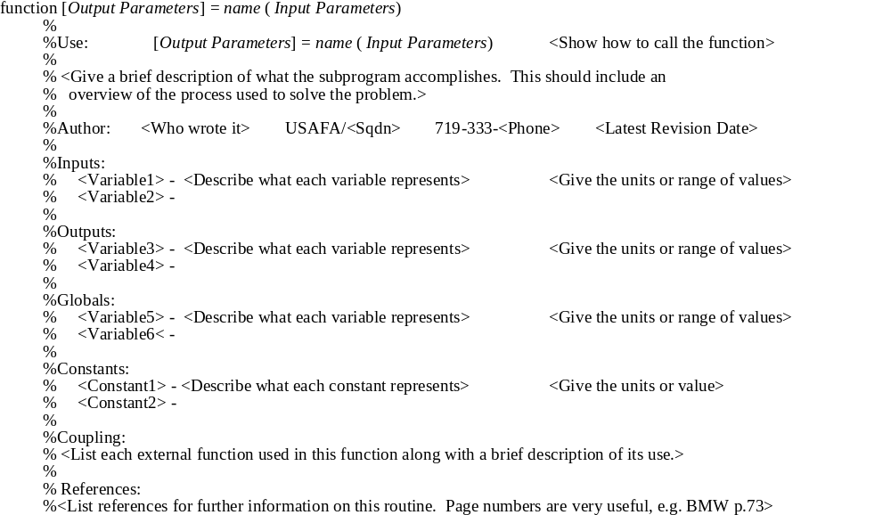

Slide 8
function x = add(a,b)
%%%%%%%%%%%%%%%%%%%%%%%%%%%%%%%%%%%%%%%%%%%%%%%%%%%%%%%%%%%%
%
% Use: x = add(a,b)
%
% The function "add" sums the input values a and b
%
% Author: Scott Dahlke USAFA/DFAS 719-333-4110
%
% Inputs:
% a - a scalar number (any unit desired)
% b - a scalar number (same units as a)
%
% Outputs:
% x - the sum of a and b (same units as a)
%
% Globals: None
%
% Constants: None
%
% Coupling: None (list only non-standard Matlab functions)
%
% References:
% Advanced Engr. Mathematics, Kreyszig pg 1
%%%%%%%%%%%%%%%%%%%%%%%%%%%%%%%%%%%%%%%%%%%%%%%%%%%%%%%%%%%%%

Slide 9
DFAS Standards Highlights
Usage block at beginning
  Input and output variables
  Example line using the program
In-line documentation
  Math operations
  Loop descriptions
Use blank lines to separate groups of calculations for readability

Slide 10
DFAS Standards Highlights
Example
Note the use of blank lines and grouping
  % Compute the final position
  x = a + b;
  pos = x/2;
  % compute the final velocity
  y = c - d;
  vel = y/2;

Slide 11
How do I validate that a program is working?
When your program runs without a syntax error, you might sometimes just be so relieved, you don’t think as to whether the results it generates are correct
You must have a way to give you confidence that what comes out is what you expect

Slide 12
How do I validate that a program is working?
Come up with a test case that you have determined answers for by another means
  Hand calculations
  Previously validated program/application
Run the test case and check for matching results

Slide 13
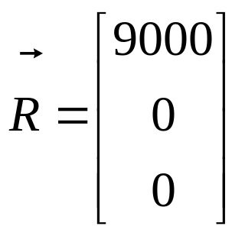
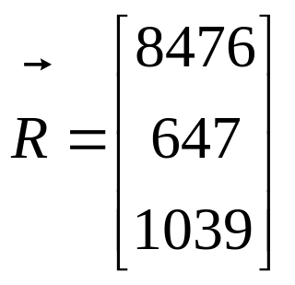
How do I validate that a program is working?
For example you might use simple numbers like:
Instead of something more complicated like:

Slide 14
How do I validate that a program is working?
Sometimes you will have to generate several tests to test all of the code
For example some code we will write will depend on whether the angle is greater or less than 180 degrees. We will need two test cases for this

Slide 15
Validation Exercise
For the Matlab program kinemat.m
Document the code
Validate that it is working

Slide 16
Summary
What is documentation?
Why is documentation important?
What is the standard for documentation?
How does one validate that a program works?
How do you test a program?

